Slide 1


MIE 1624 Final Project
March 31st, 2020
Prof. Oleksandr Romenko
Group 15

Slide 2





Meet Our Team
Mostafa Kouchakzadeh
Zhaohui
Qu
Zichuan
Wang
Sam Weinberg
(1006131240)
m.Kouchakzadeh@mail.utoronto.ca
(1005783127)
zh.qu@mail.utoronto.ca
(1000474300)
zichuan.wang@mail.utoronto.ca
(1005347634)
sam.weinberg@mail.utoronto.ca

Slide 3
MIE 1624 Redesigned Curriculum

Slide 4


Course Structure
Popular Topics
Web scraping of online job board for data science and analytics roles
In-demand Skills
Analyzing the results of a global survey of data science professionals by Kaggle
The techniques we employed for analysis included:
Web
Scraping
Term
Frequency
Clustering
Algorithms
Data
Visualization
Notes:
In the first part of this project, we want to redesign the course structure for MIE 1624. This will include the materials, which need to be covered in this course as well as skills that need to be developed after taking this course. It is essential to analyze datasets to figure out demanding skills in the field of data science and analytics. We decided to use two different approaches for our analysis. The first approach would be analyzing skills based on a salary perspective. Kaggle surveys from 2018 and 2019 for this methodology was used. The second approach would be analyzing skills based on the demand in the industry. For this part, we performed a web scraping on Indeed website for data science and data analytics job postings. In addition to the web scraping, we used a dataset from Kaggle that included job postings from the U.S in the field of data science and analytics.

Slide 5
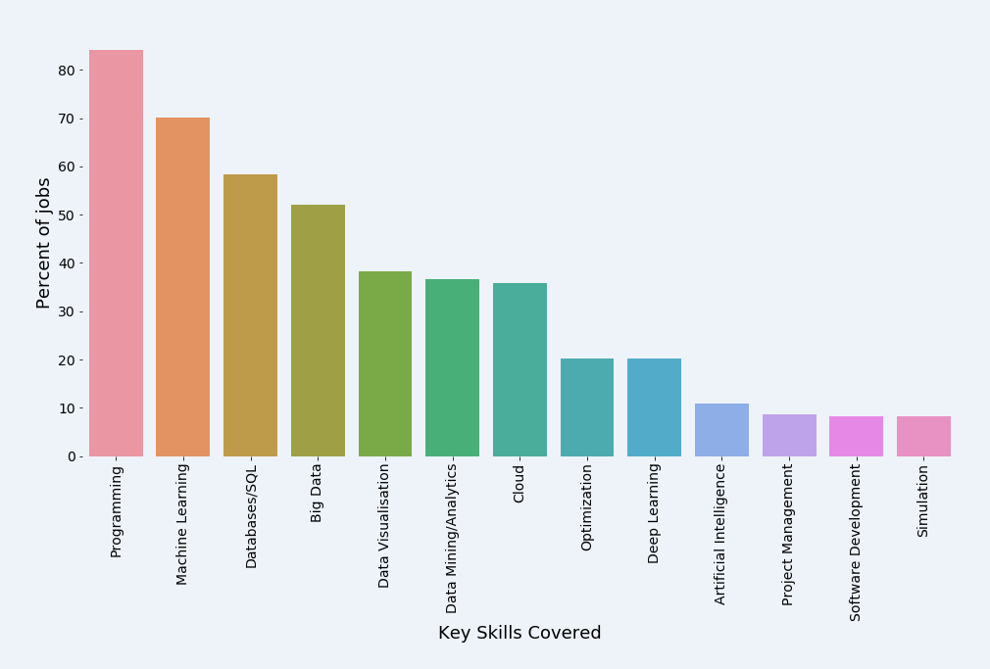
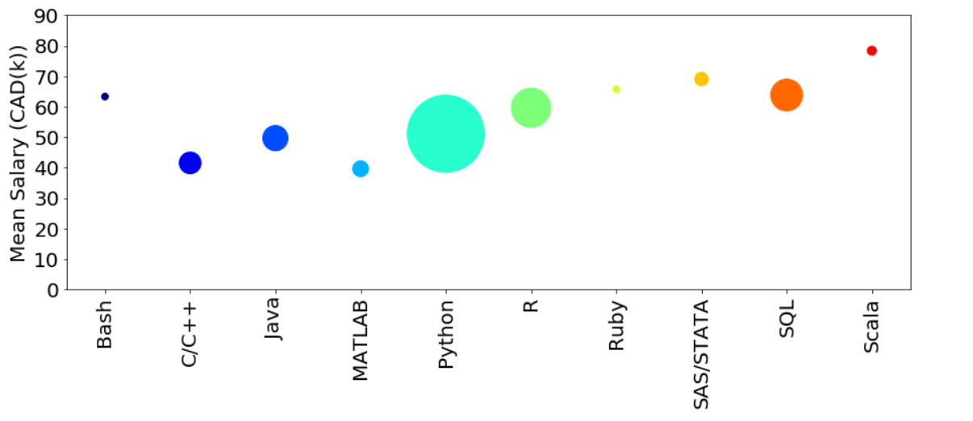
Analysis Results
Salary wise approach
Demand wise approach
Size shows the frequency
Primary programming languages: Python, R and SQL
Machine learning, Database and SQL, Cloud
Data visualization, Optimization, Big data
Notes:
Programming is an essential tool for data scientists. So we need to understand which programming languages should be used in our course.
Based on the surveys that we had in 2018 and 2019, we realized that Python, R, and SQL are the primary programming languages in data science. However, Python is the most frequent programming language, but R and SQL contribute to a higher salary.
As we can see from the analysis, Machine learning and Database are among the most important skills. I addition, many job postings asked for applicants who are familiar with big data, and visualization which are not focused on this course. Cloud and optimization are other skilss that worth focusing on in introduction to data science analytics.

Slide 6


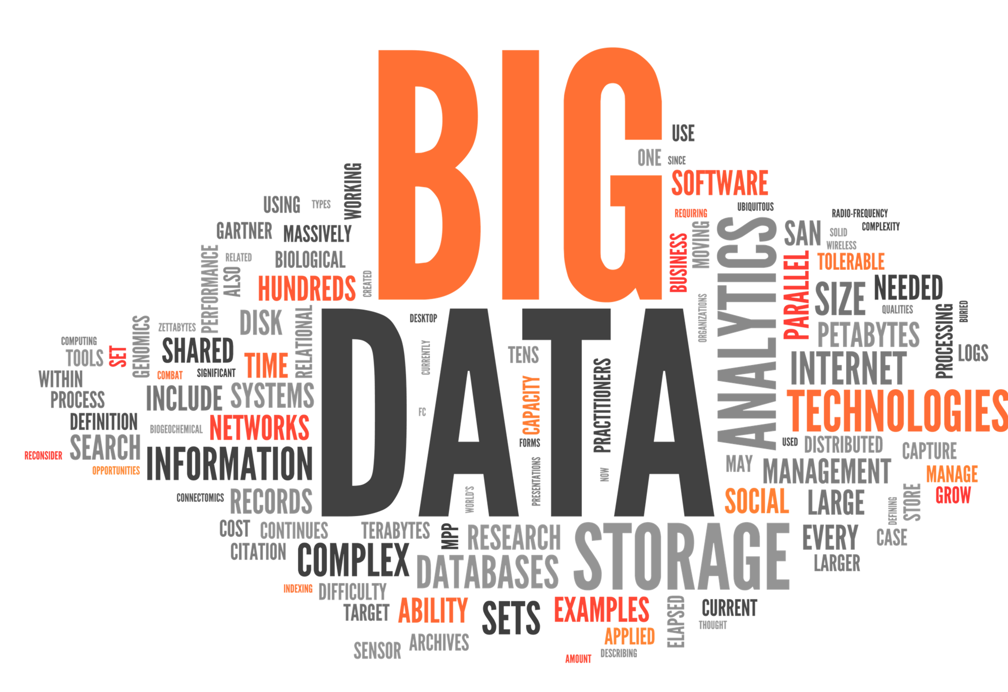
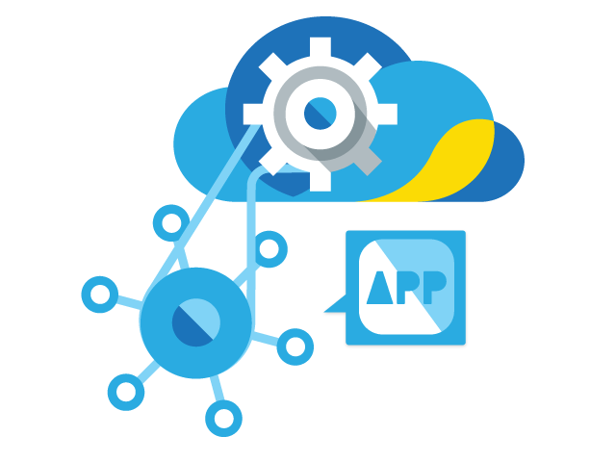
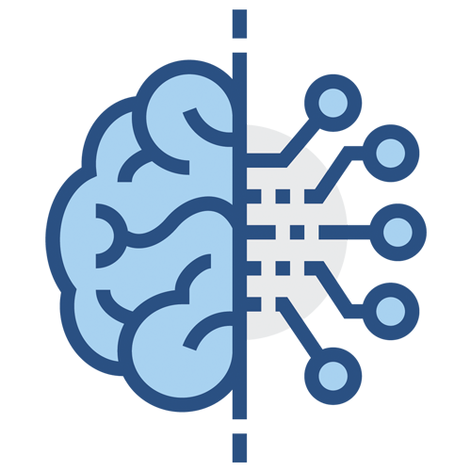







Simulation &
Optimization
Assignment 3
Big Data
Big Data
Group Project
Cloud Computing
Cloud Computing
Assignment 2
Machine Learning Algorithm
Machine Learning Algorithm and AI (unsupervised)
Data Analysis
Databases and SQL
Assignment 1
Data Analysis
with SQL Database
Machine Learning Algorithm and AI (supervised)
Linear Algebra
Statistics
Introduction
Course structure
Notes:
Similar to the beginning of the course we need to start with some intros about data science and analytics and in what field this skill is useful. Statics in one of the most important part of the course, we assume students have basic knowledge about statistics so a review would increase the efficiency of the class. Similar to statistics Math and linear algebra are essential for understanding the foundation of many algorithms. Therefore, we allocated a specific lecture to review their basics. We will start the fourth lecture with data visualization and how to clean data, assignment 1 which is about data analysis with SQL database will be published. After doing some primary data cleaning students now are ready to learn about the concepts of databses and SQL to finish the first assignment. In the next lecture, different supervised machine learning algorithm will be discussed, the main focus would be on several methods not to overwhelm students. Assignment 2 which is about implication of machine learning would be distributed among the students. Due to the importance of machine learning, we want to allocate another lecture to unsupervised machine learning algorithms. In the meantime group project which is about cloud programming and API would be published. 8th lecture would talk about cloud and API so students have the fundamentals to start the project. The last two lectures would teach the basics of big data and simulation and optimization. The last assignment which is about big data analytics and optimization would be the last part of this course and we do not plan to have a final exam.

Slide 7
Masters of Data Science and AI Program

Slide 8
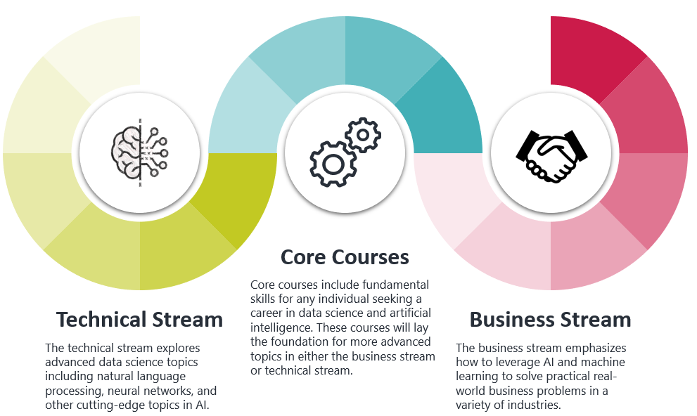
Curriculum Overview
Master of Data Science and AI program is separated into two streams: Technical Stream and Business Stream. All students are required to take four core courses on fundamental data science topics before splitting off into specialized courses.
Notes:
The Master of Data Science and Artificial Intelligence program aims to provide students with knowledge and experience to become elite data scientists and business professionals. The program is 12 months long with four courses per semester and a culminating industry project. The program contains four core courses, which are mandatory for all students and provide a solid foundation in data analytics and AI. Students then have the option to choose the business stream or technical stream, where they will take specialized courses that build on top of the fundamental skillss.

Slide 9
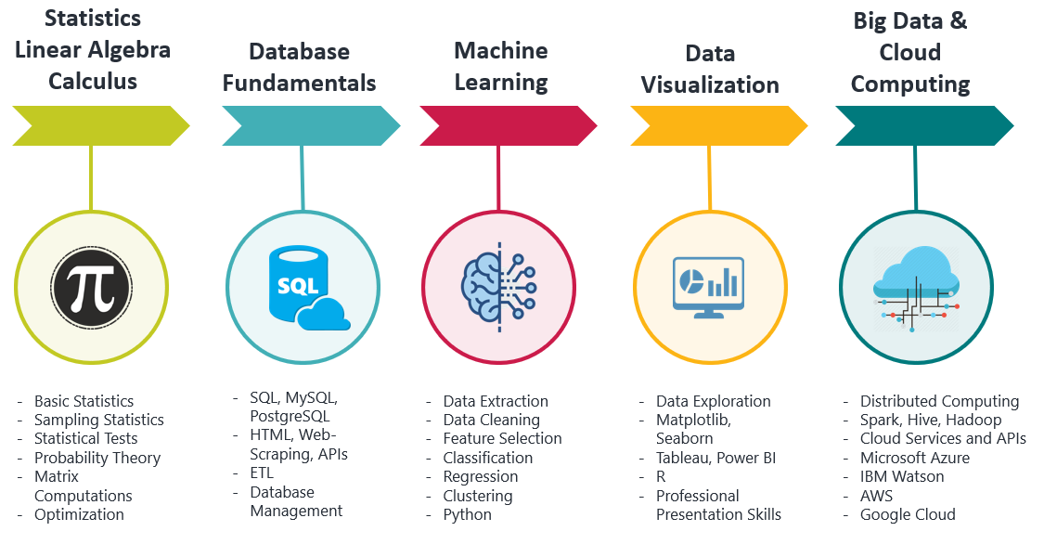
Core Courses
Students are required to complete Udemy bootcamps in Statistics, Linear Algebra, and Calculus as a prerequisite to the program. The four core courses provide a solid foundation in essential, high-demand data science skills.
Notes:
The core courses were designed based on the skills that were in highest demand from the analysis in part one. They are also composed based on a hierarchical clustering analysis of job postings, which demonstrates the skills that synergize with each other.
Students are required to complete Udemy bootcamps in statistics, linear algebra, and calculus prior to beginning their studies. The four core courses include database fundamentals, introductory machine learning, data visualization, and big data and cloud computing.

Slide 10
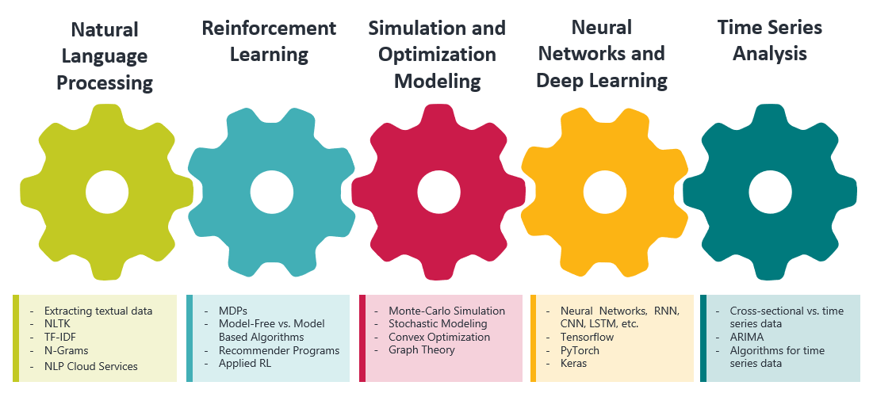
Technical Program
Master of Data Science and AI (MDSA) program is designed to provide students with a comprehensive technical background in the most current and state-of-the-art technologies in AI.
Notes:
The technical stream includes current topics in machine learning and AI that have peaked the interest of companies from several industries. These constitute state-of-the-art techniques and algorithms that are becoming increasingly useful as their business applications are realized. The courses include Natural Language Processing, Reinforcement Learning, Simulation and Optimization Modeling, Neural Networks and Deep Learning, and Time Series Analysis. Students are required to take 4 out of the 5 courses.

Slide 11






Business Program
Marketing Analytics
Market segments construction
Product design and positioning
Advertising
Master of Business and Management in Analytics (MBMA) is designed to meet the growing need for talented professionals with the skills and advanced applied knowledge to create, implement and evaluate AI-related applications and technologies.
Financial Analytics
Predictive sales analytics
Client/Product profitability analytics
Cash flow analytics
eCommerce Analytics
KPI hierarchy for task prioritization
Customer life-time value
Customer acquisition cost
Business
Program
Risk Analytics
- Operational risk & fraud analytics
Credit risk modeling
Investment & Insurance analytics
Supply Chain Analytics
- Network design
Assortment and price optimization
Inventory management
Notes:
Master of Business and Management in Analytics (MBMA) is designed to meet the growing need for talented professionals with the skills and advanced applied knowledge to create, implement and evaluate AI-related applications and technologies.
The immersive curriculum of our MBMA program offers a solid technical foundation of data analytics and machine learning and provides a guide on how to use them to achieve important business objectives. There are 5 courses for the business stream including Analytics for Marketing Strategy, Analytics for Finance and Accounting, Analytics for Supply Chain and Logistics, Analytics for Risk Management, Analytics for Ecommerce at Scale. These courses forms five business pillars that align with the strongest marketplace demand for business and management analytics professionals.

Slide 12
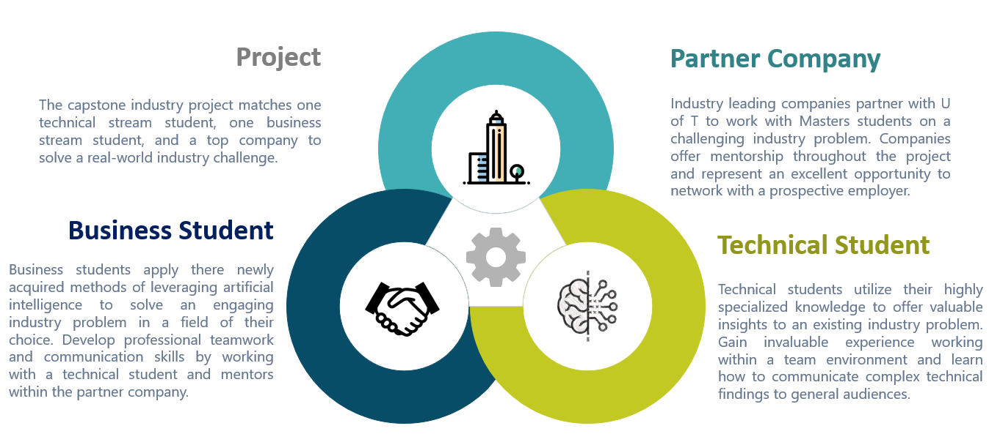
Data Science Consulting Practicum
Data Science Consulting Practicum is a capstone project that matches one business student, one technical student and a partner company to collaborate on a challenging business problem using their newly acquire knowledge of artificial intelligence.
Notes:
The Data Science Consulting Practicum is the capstone project for the Masters Program which all students must complete. The project matches one business student, one technical student, and a parent company to utilize Artificial Intelligence and solve a current, practical industry problem. Students learn valuable lessons on how to communicate with individuals with varying degrees of technical background, and obtain mentorship from industry professionals at the partner company. The project represents and excellent opportunity to gain relevant work experience and make a strong impression on a potential employer.

Slide 13
EdTech Startup: Insight Data Science

Slide 14


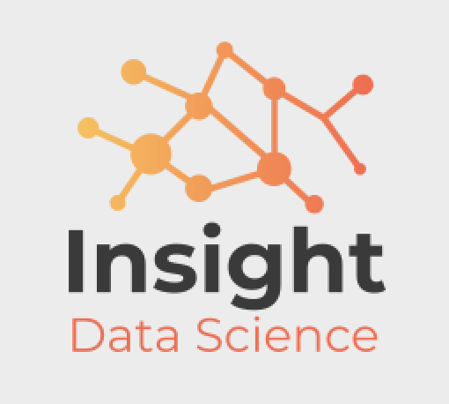
EdTech Program
Insight Data Science aims at answering the fast-growing demand of the job market for new skills and competencies related to advanced fields of Data Science and Artificial Intelligence and relevant for IT, Banking, Insurance industries as well as research institution.
Insurance Analytics
- Insurance Underwriting
Risk Management
Claims Prediction
Academic Research
Natural Language Processing
Computer Vision
Deep Learning
Financial Analytics
Portfolio Management
Algorithmic Trading
Fraud Detection
Information Technology
Virtual Personal Assistant
Product Recommendation
Email Spam Filtering
Notes:
Our Edtech program, Insight Data Science, aims at answering the fast-growing demand of the job market for new skills and competencies related to advanced fields of Data Science and Artificial Intelligence and relevant for Information Technology, Finance, Insurance as well as Academic Research. It is a program that matches one business student, one technical student and a partner company to collaborate on an open-ended business problem using the power artificial intelligence.
Some potential projects include but not limited to virtual personal assistant development, computer vision, AI assisted portfolio management and insurance underwriting.

Slide 15
Questions?

Slide 16

Core Courses
Statistics Linear Algebra Calculus
Big Data & Cloud Computing
Database Fundamentals
Machine Learning
Data Visualization
Basic Statistics
Sampling Statistics
Statistical Tests
Probability Theory
Matrix Computations
Optimization
SQL, MySQL, PostgreSQL
HTML, Web-Scraping, APIs
ETL
Database Management
Data Extraction
Data Cleaning
Feature Selection
Classification
Regression
Clustering
Python
Data Exploration
Matplotlib, Seaborn
Tableau, Power BI
R
Professional Presentation Skills
Distributed Computing
Spark, Hive, Hadoop
Cloud Services and APIs
Microsoft Azure
IBM Watson
AWS
Google Cloud

Slide 17



Industry Project
Project
Partner Company
The capstone industry project matches one technical stream student, one business stream student, and a top company to solve a real-world industry challenge.
Industry leading companies partner with U of T to work with Masters students on a challenging industry problem. Companies offer mentorship throughout the project and represent an excellent opportunity to network with a prospective employer.
Business Student
Technical Student
Business students apply there newly acquired methods of leveraging artificial intelligence to solve an engaging industry problem in a field of their choice. Develop professional teamwork and communication skills by working with a technical student and mentors within the partner company.
Technical students utilize their highly specialized knowledge to offer valuable insights to an existing industry problem. Gain invaluable experience working within a team environment and learn how to communicate complex technical findings to general audiences.
Notes:
© Copyright PresentationGo.com – The free PowerPoint template library

Slide 18
Curriculum Overview
Core Courses
Core courses include fundamental skills for any individual seeking a career in data science and artificial intelligence. These courses will lay the foundation for more advanced topics in either the business stream or technical stream.
Technical Stream
Business Stream
The technical stream explores advanced data science topics including natural language processing, neural networks, and other cutting-edge topics in AI.
The business stream emphasizes how to leverage AI and machine learning to solve practical real-world business problems in a variety of industries.

